Slide 1
Exception Handling

Slide 2
What is Exception?
An exception is an event, which occurs during the execution of a program that disrupts the normal flow of the program’s instructions.
In general, when a Python script encounters a situation that it cannot cope with, it raises an exception.
An exception is a Python object that represents an error.
When a Python script (code) raises an exception, it must either handle the exception immediately otherwise it terminates and quits.

Slide 3
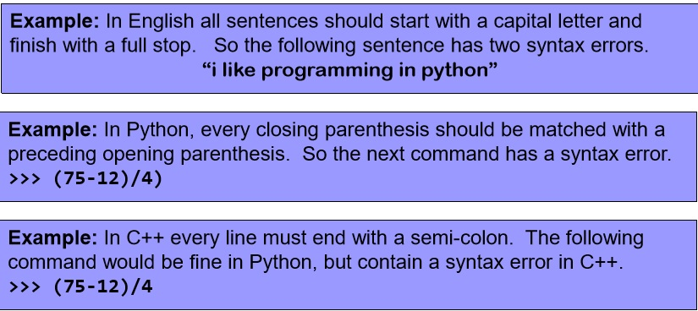
Syntax Error vs Runtime Error
Syntax Error are those error which is occurred due to the invalid syntax.

Slide 4
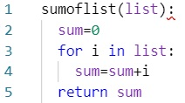


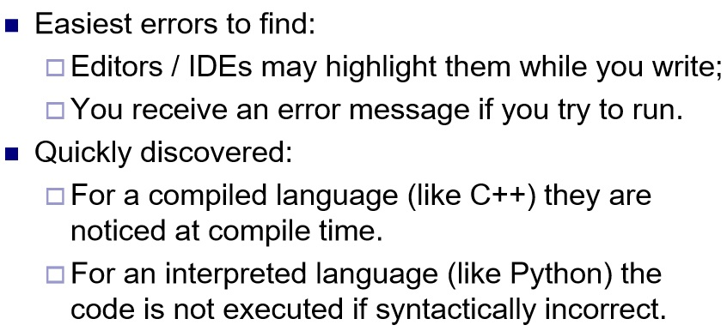
Code:

Slide 5
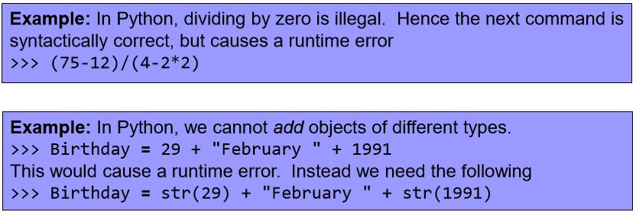
Runtime Errors:
Runtime error are those error which is occurred at runtime(execution time).
Code was syntactically correct, but the error occurs when the program is executing.
Runtime Error is also known as exception.

Slide 6
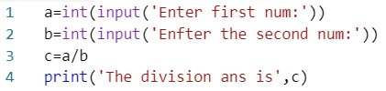

Code:
If the value of b is 0.
If we input value ‘ten’ instead of 10.
If the file ‘soft.txt’ is not available

Slide 7
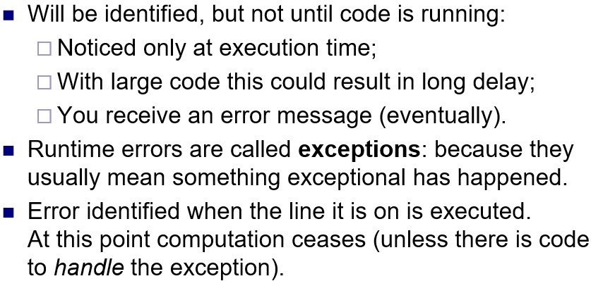
Runtime Error

Slide 8



?
?
What is Exception?
=
=

Slide 9
Points to remember:
Exception is the unwanted, unexpected event that occur during execution of program that stops normal flow of your program.
Exceptions are the Run-time Errors.
As we know Exception terminate your program, it should be handled by the programmer.

Slide 10
Exception-Handling?
The process of handling the runtime errors (exception) occurred during the execution of program is known as Exception-Handling.
Defining alternative way to continue rest of the program normally.
Objectives:
In order to stop the abnormal flow of execution.
Providing user-friendly message.
Continuing rest of program.

Slide 11
Think:
What are the errors that you get when an exception occur?
From where they are coming?
Python has many built-in exceptions which forces your program to output an error when something in it goes wrong.

Slide 12
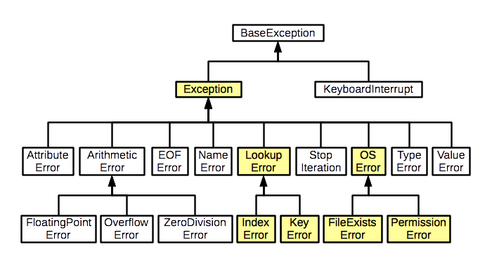
Exception Hierarchy in Python:
These are the built-in exception in Python.

Slide 13
How Exception occur:
Throw object at line 3.
PVM
Match the exception and make the object of exception : throw that in your program
Execute
Enter first num: 5
Enter the second num:0
Line 3 c = a/b
[Error occurred: cannot dived by 0]

Slide 14
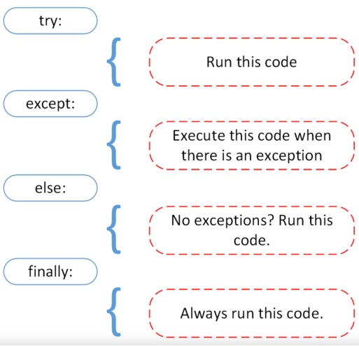
How to handle this?: Exception Handling
To handle exception properly in Python, We have four keywords: try, except, else and finally.

Slide 15

Throw object at line 3.
PVM
Match the exception and make the object of exception : throw that in your program
Execute
Enter first num: 5
Enter the second num:0
Line 3 c = a/b
[Error occurred: cannot dived by 0]

Slide 16
try block :
if the Python program contains suspicious code that may throw the exception, we must place that code in the try block.
The try block must be followed with the except block which contains a block of code that will be executed if there is some exception in the try block.
Try block contains the risky code

Slide 17
except block –
It contains the error handling code(alternative code).
else block –
It contains the code which should be executed if the exception do not occur.
finally block –
it contains the code which should be executed whether exception occur or not.

Slide 18
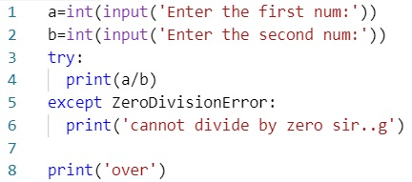


Code:
If exception occur this will handle the code and stops from abnormal termination and executes rest of the code.

Slide 19
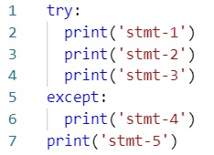
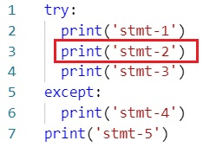
Control flow in try-except block
?
Case-1: if exception do not occur
?
Case-2: if exception occur at line3

Slide 20
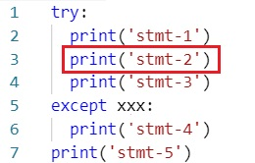
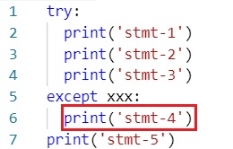
?
Case-3: if exception occur at line 3 but corresponding except block do not matched
?
Case-4: if exception occur at line 6.

Slide 21
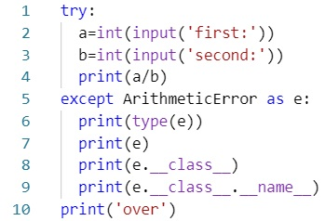
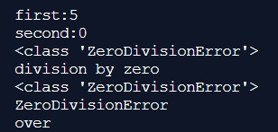
How to print except information:

Slide 22
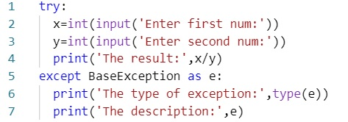
Handling more than one exception:
Possible error:
ZeroDivisionError and ValueError
Such method handling error is suitable if you want to print the type of error and message.
If you want to handle it by writing alternative code then it will have problem.
Example – For every different questions in exam papers, we didn’t provide same answer.
If there is different question, we provide different answers.

Slide 23
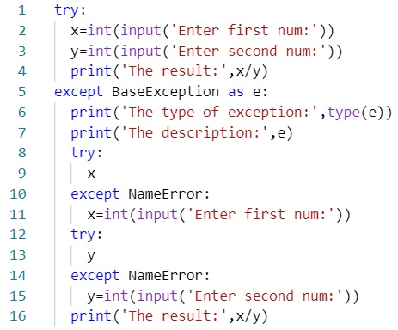
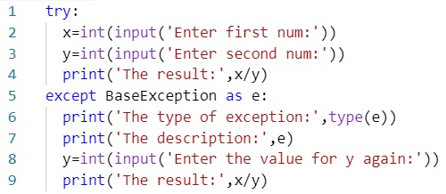
Problems:
OR
We can not write the above both different except block code in a single except block because both exception do not occurred at same time.
But point to remember is that both exception can occurred in same code at a single time.
So then what will be the solution????? ➔ try block with multiple except blocks

Slide 24
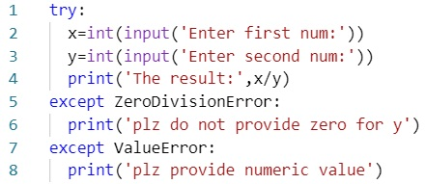
try with multiple except blocks:
If exception occurred.
1
2
The way of handling an exception is varied from exception to exception.
Hence for every possible exception type, we have to take a separate except block. try with multiple except block is possible and recommended to use.
If try with multiple except blocks available then the order of these except blocks is important.
Python virtual machine will always consider from top to bottom until matched except block identified.

Slide 25
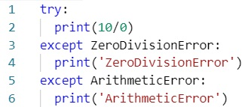
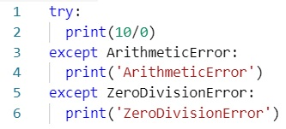
Maintain hierarchy:
?
?

Slide 26
Single except block that can handle multiple different exceptions:
If handling code is same for multiple exceptions, then instead of taking different except blocks, we can take single except block that can handle all those exceptions.
except(exception1,exception2, ….):
except(exception1, exception2, …..) as msg:
Parenthesis are mandatory and this group of exceptions internally considered as tuple.

Slide 27
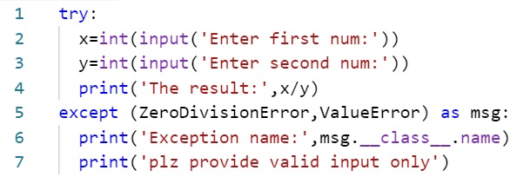
Example:

Slide 28
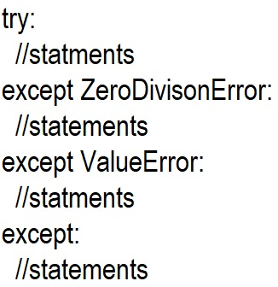
Default except Block:
We can use default except block to handle any type of exceptions.
In default except block, generally we can print exception information to console.
Remember: Default except block always should be last otherwise syntax error.
Example:

Slide 29
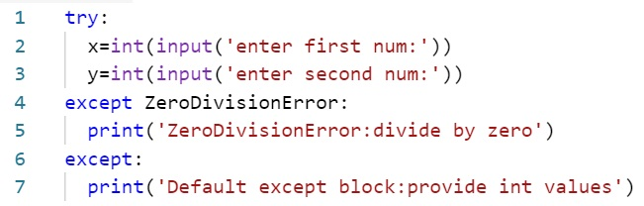
Code Example:

Slide 30
Various possible combinations of except block:
except ZeroDivisionError:
except (ZeroDivisionError):
except ZeroDivsionError as msg:
except(ZeroDivsionError) as msg:
except(ZeroDivisonError, ValueError):
except(ZeroDivisionError, ValueError) as msg:
except

Slide 31
Questions:
Except(ZeroDivisionError as msg):
Except ZeroDivisonError, ValueError:
Except (ZeroDivisionError, ValueError as msg):
?
?
?

Slide 32
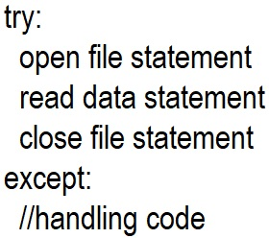
finally block:
It is not recommended to place clean-up code (resource deallocation code like closing file connection, closing database connection etc) inside try block, because there is no guarantee for execution of every statement inside try block.

Slide 33
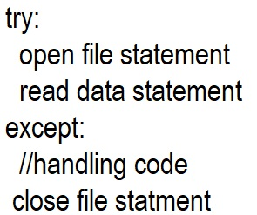
finally block:
It is not recommended to place clean-up code inside except block, because if there is no exception then except block won’t be executed.

Slide 34
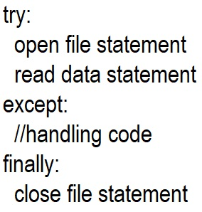
finally block:
Hence we required some place to maintain clean-up code which should be executed always irrespective of whether exception raised or not. Such type of best place is nothing but finally block.
Hence main purpose of finally block is to maintain clean-up code.

Slide 35
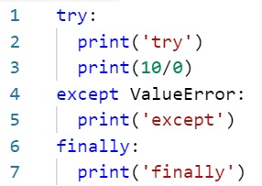
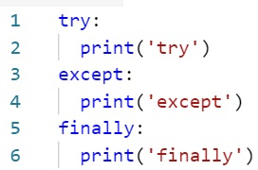
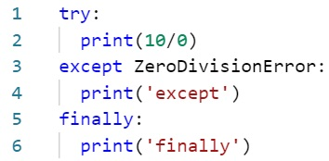
Exercise:
Case1: if no exception occur.
Case2: if exception raised and handle
Case3: if exception raised and not handle.
?

Slide 36
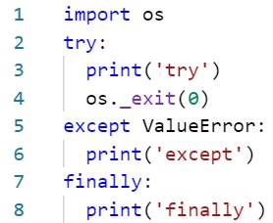
finally block:
Finally block is always executed whether the exception occurred or not.
Is finally block is always executed?
No, there is one situation, if the try block is executing and suddenly power is off. In this situation the pvm get exit and the whole process will stop.
os._exit(0) → 0 means normal termination. non zero abnormal termination.

Slide 37
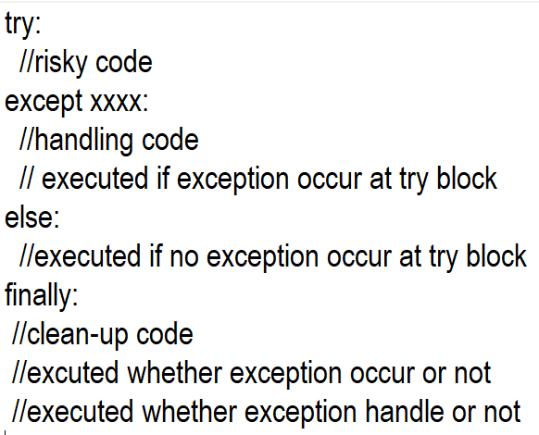
else block:
Else block is executed if no exception occurred at try block.

Slide 38
else block:
There is no chance of executing both except and else simultaneously.
If we want to take else block, compulsory except block should be there. i.e. else without except block is invalid.
SyntaxError: invalid syntax

Slide 39
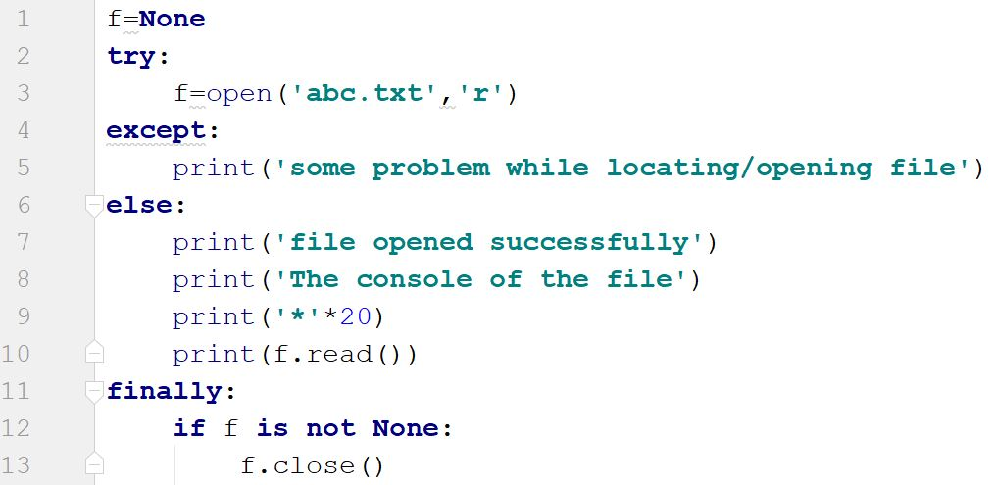
Code Example:

Slide 40
Types of Exceptions:
Predefined Exceptions:
User Define Exceptions

Slide 41
Predefined Exception:
Also known as in-built exceptions or PVM exception.
These will be raised automatically by Python Virtual Machine whenever a particular event occurs.
Print(5/0) # ZeroDivisionError
X=int(‘five’) # ValueError
F=open(‘abc.txt’) # if file is not there – FilenotFoundError
L=[5,3] # print(l[5]) – IndexError

Slide 42
User Define Exception:
Also known as customized Exception or Programmatic Exceptions.
Sometimes we have to define and raise exceptions explicitly to indicate that something goes wrong, such type of exceptions are called user defined exceptions or customized exceptions or programmatic exceptions.
Programmer is responsible to define these exceptions and Python Virtual Machine not having any idea about these. Hence we have to raise explicitly based on our requirement by using ‘raise’ keyword.

Slide 43
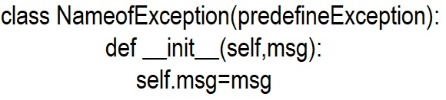
How to define user defined exception:
Every exception in Python is a class and it should be child class of BaseException.

Slide 44
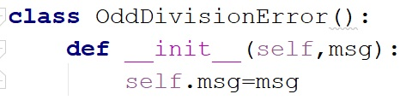
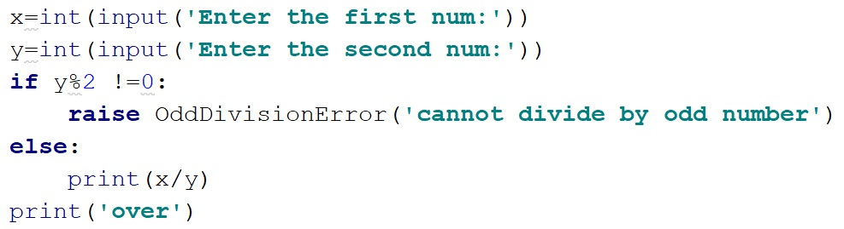
Code Example:

Slide 45
**The – End**

